Slide 1

Data Pirates
Know your music

Slide 2

TEAM MEMBERS
Ramyaa Vivek
Alex Stanley
Jeni Arulraj

Slide 3


Data Sources
Spotify extract audio features

Slide 4
Spotify Audio feature
Danceability
Valence
Popularity
Energy
Duration (ms)
Mode
Loudness (dB)
Tempo (bpm)

Slide 5


Questions we asked..?
Is Country music more popular than Rap?
Is Country music sadder than Rap?
Is Rap music more ‘speechy’ than Country?
Which is more danceable (Country or Rap)?

Slide 6
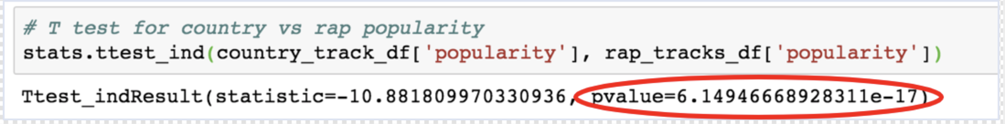
Is Country music more popular than Rap?
H0 → No popularity difference between Country & Rap music
H Alt → There is difference in popularity b/w Country & Rap music
T-test result
P-Value <0.05 (Reject H0)

Slide 7
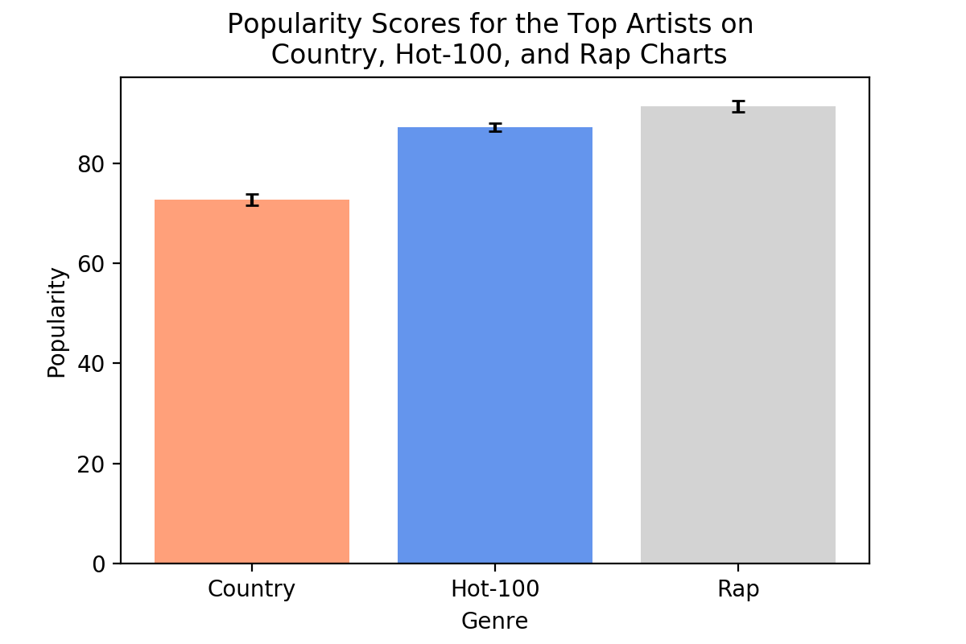
Popularity Trendline

Slide 8
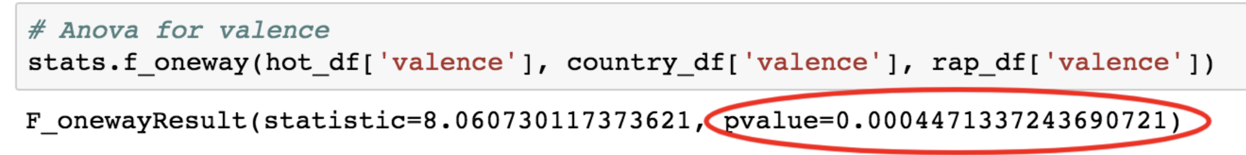
Valence: Country music vs Hot 100 vs Rap music
H0 → No difference in Valence b/w Country, Rap music & Hot 100
H Alt → There is difference in valence b/w Country, Rap music & Hot 100
T-test result
P-Value <0.05 (Reject H0)

Slide 9
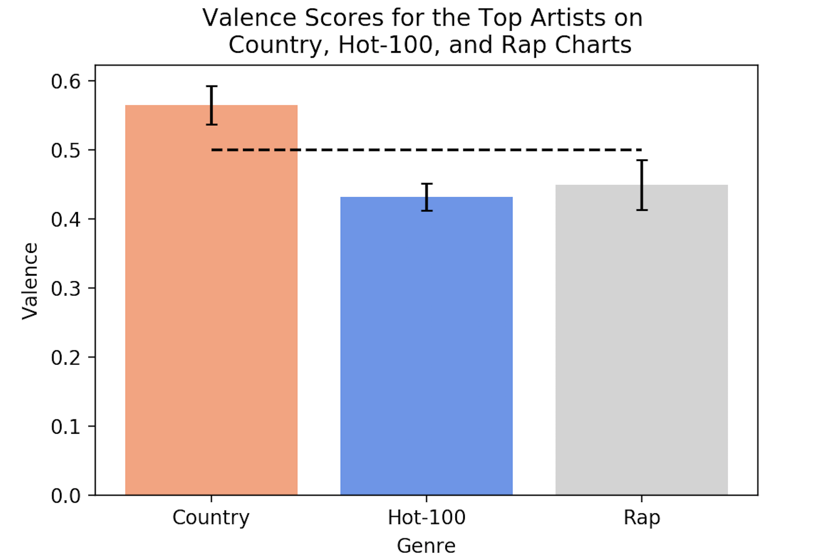
Valence- Country vs Hot 100 vs Rap Music

Slide 10
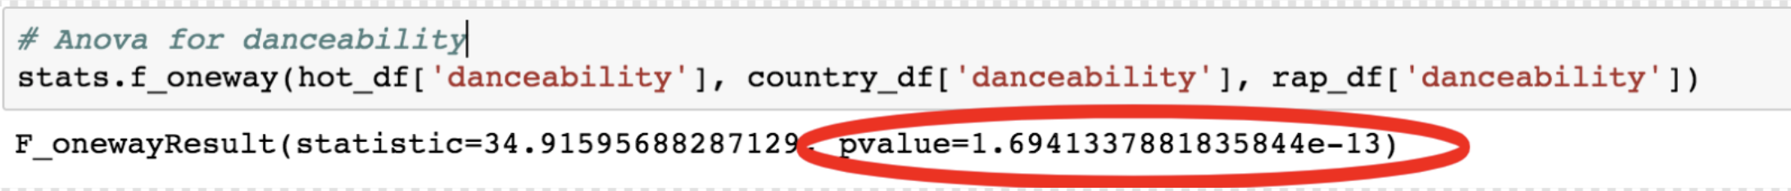
Danceability: Country music vs Hot 100 vs Rap music
H0 → No difference in danceability b/w Country, Rap music & Hot 100
H Alt → There is difference in danceability b/w Country, Rap music & Hot 100
T-test result
P-Value <0.05 (Reject H0)

Slide 11
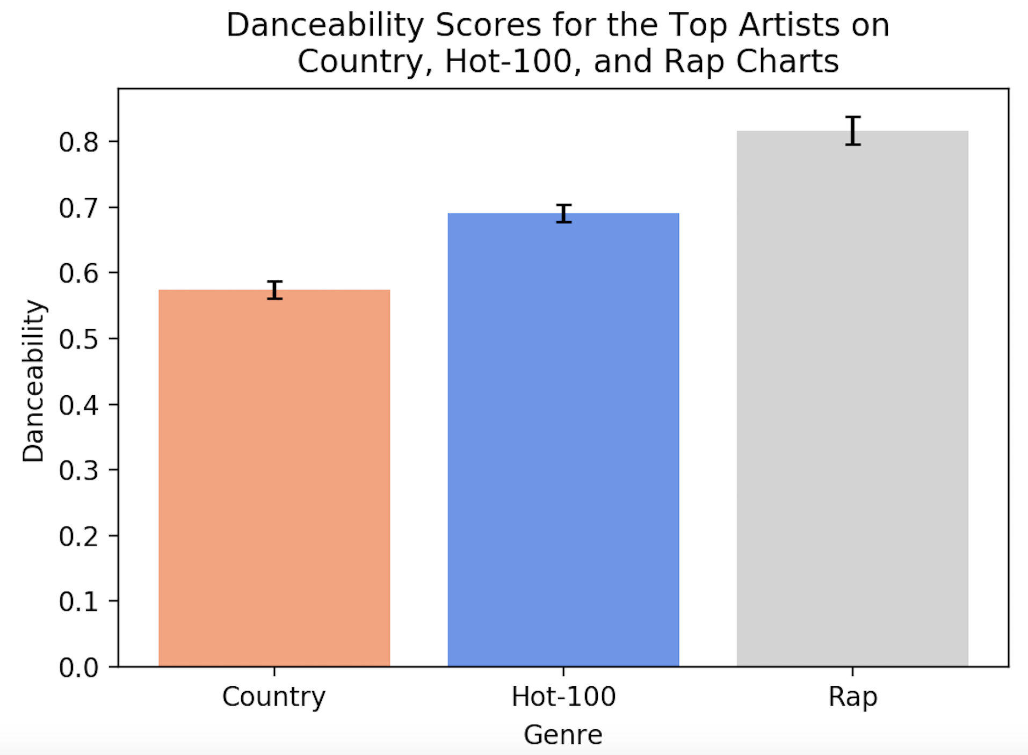
Danceability- Country vs Hot 100 vs Rap Music

Slide 12
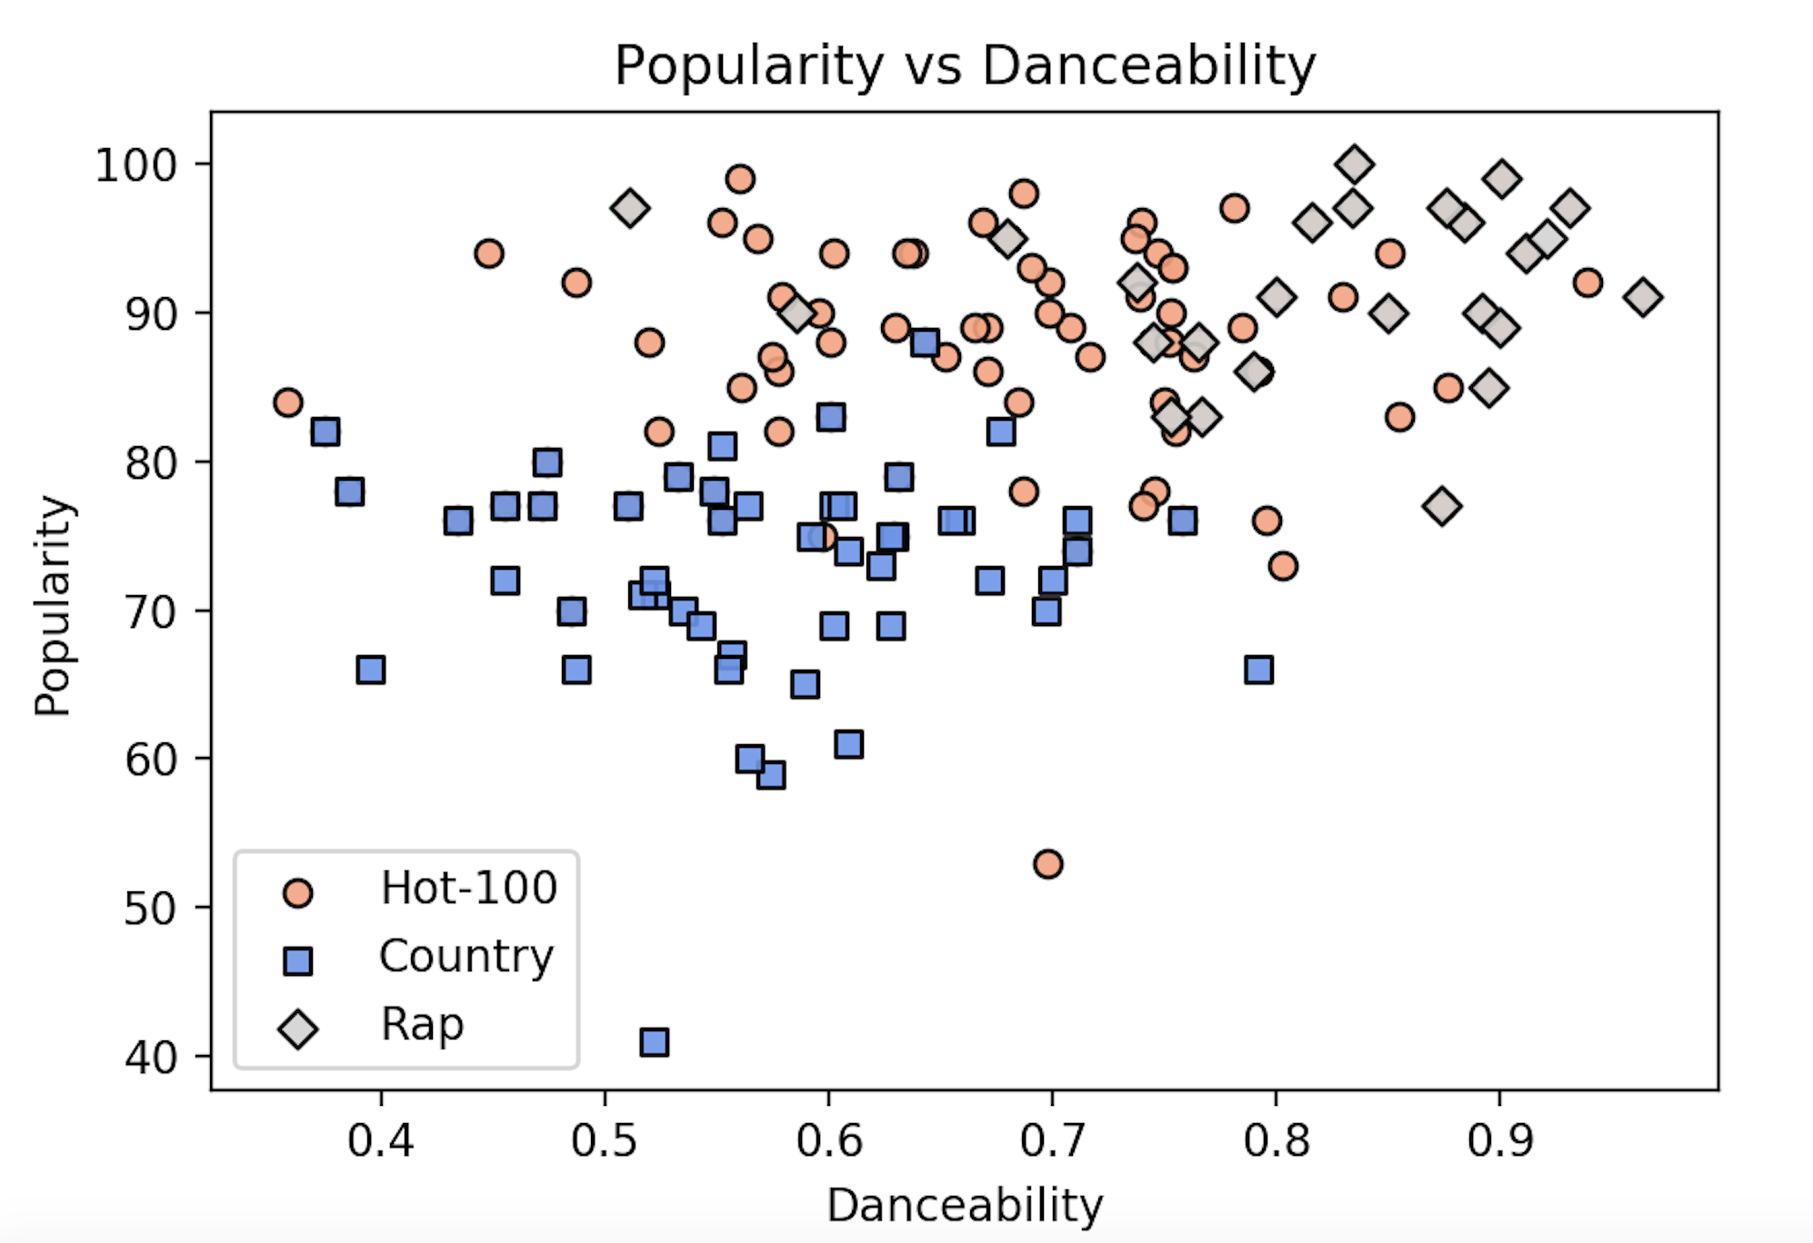
Popularity vs Danceability

Slide 13
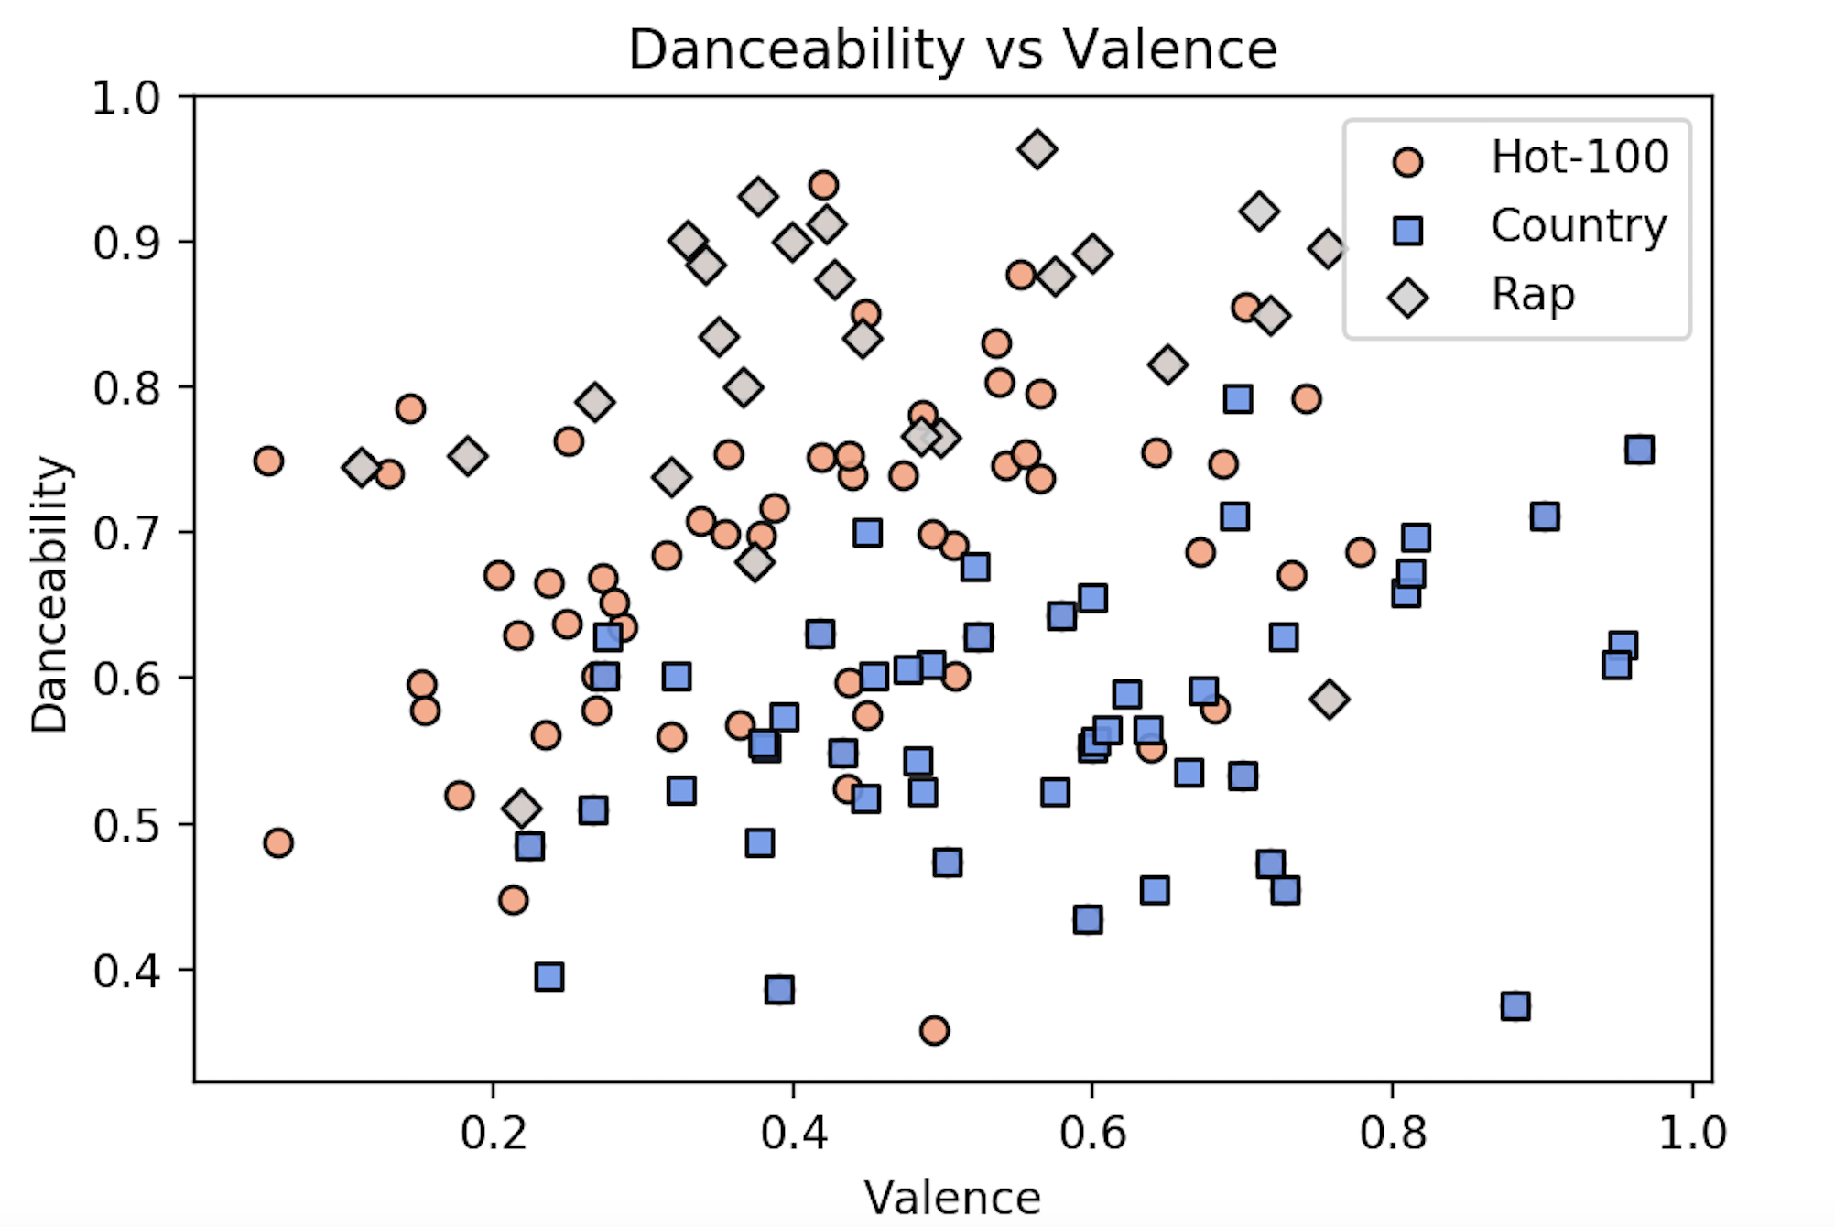
Danceability vs Valence

Slide 14
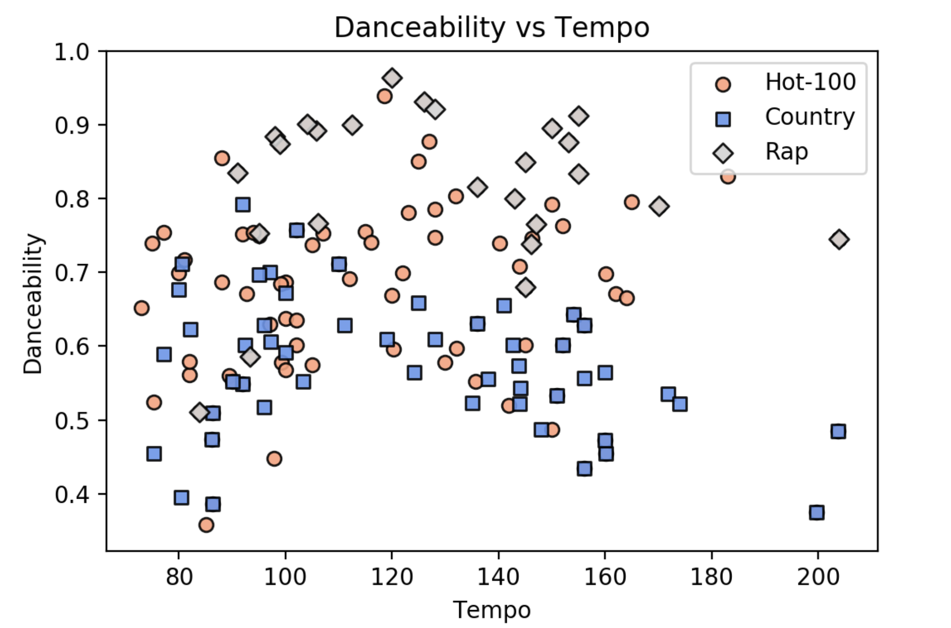
Danceability vs Tempo

Slide 15

Inference:
Popularity scores for Rap is more over country music
Country music is happier than Rap but valence or emotional touch of the song was not co-related with the popularity.
Danceability was positively co-related with popularity
Rap music is not as speechy as we thought
Country music were less danceable & low on popularity score
There wasn’t much co-relation between danceability & valence
Within each genre there was co-relation between Danceability & valence
Optimal tempo to dance is around 110 bpm

Slide 16


Final Take!
If country music is more danceable it could be more popular too!!!!!

Slide 17
Supplemental Data

Slide 18
Is Country music sadder than Rap?
H0 → No difference in valence b/w Country & Rap music
H Alt → There is difference in valence b/w Country & Rap music
T-test result
P-Value <0.05 (Reject H0)

Slide 19
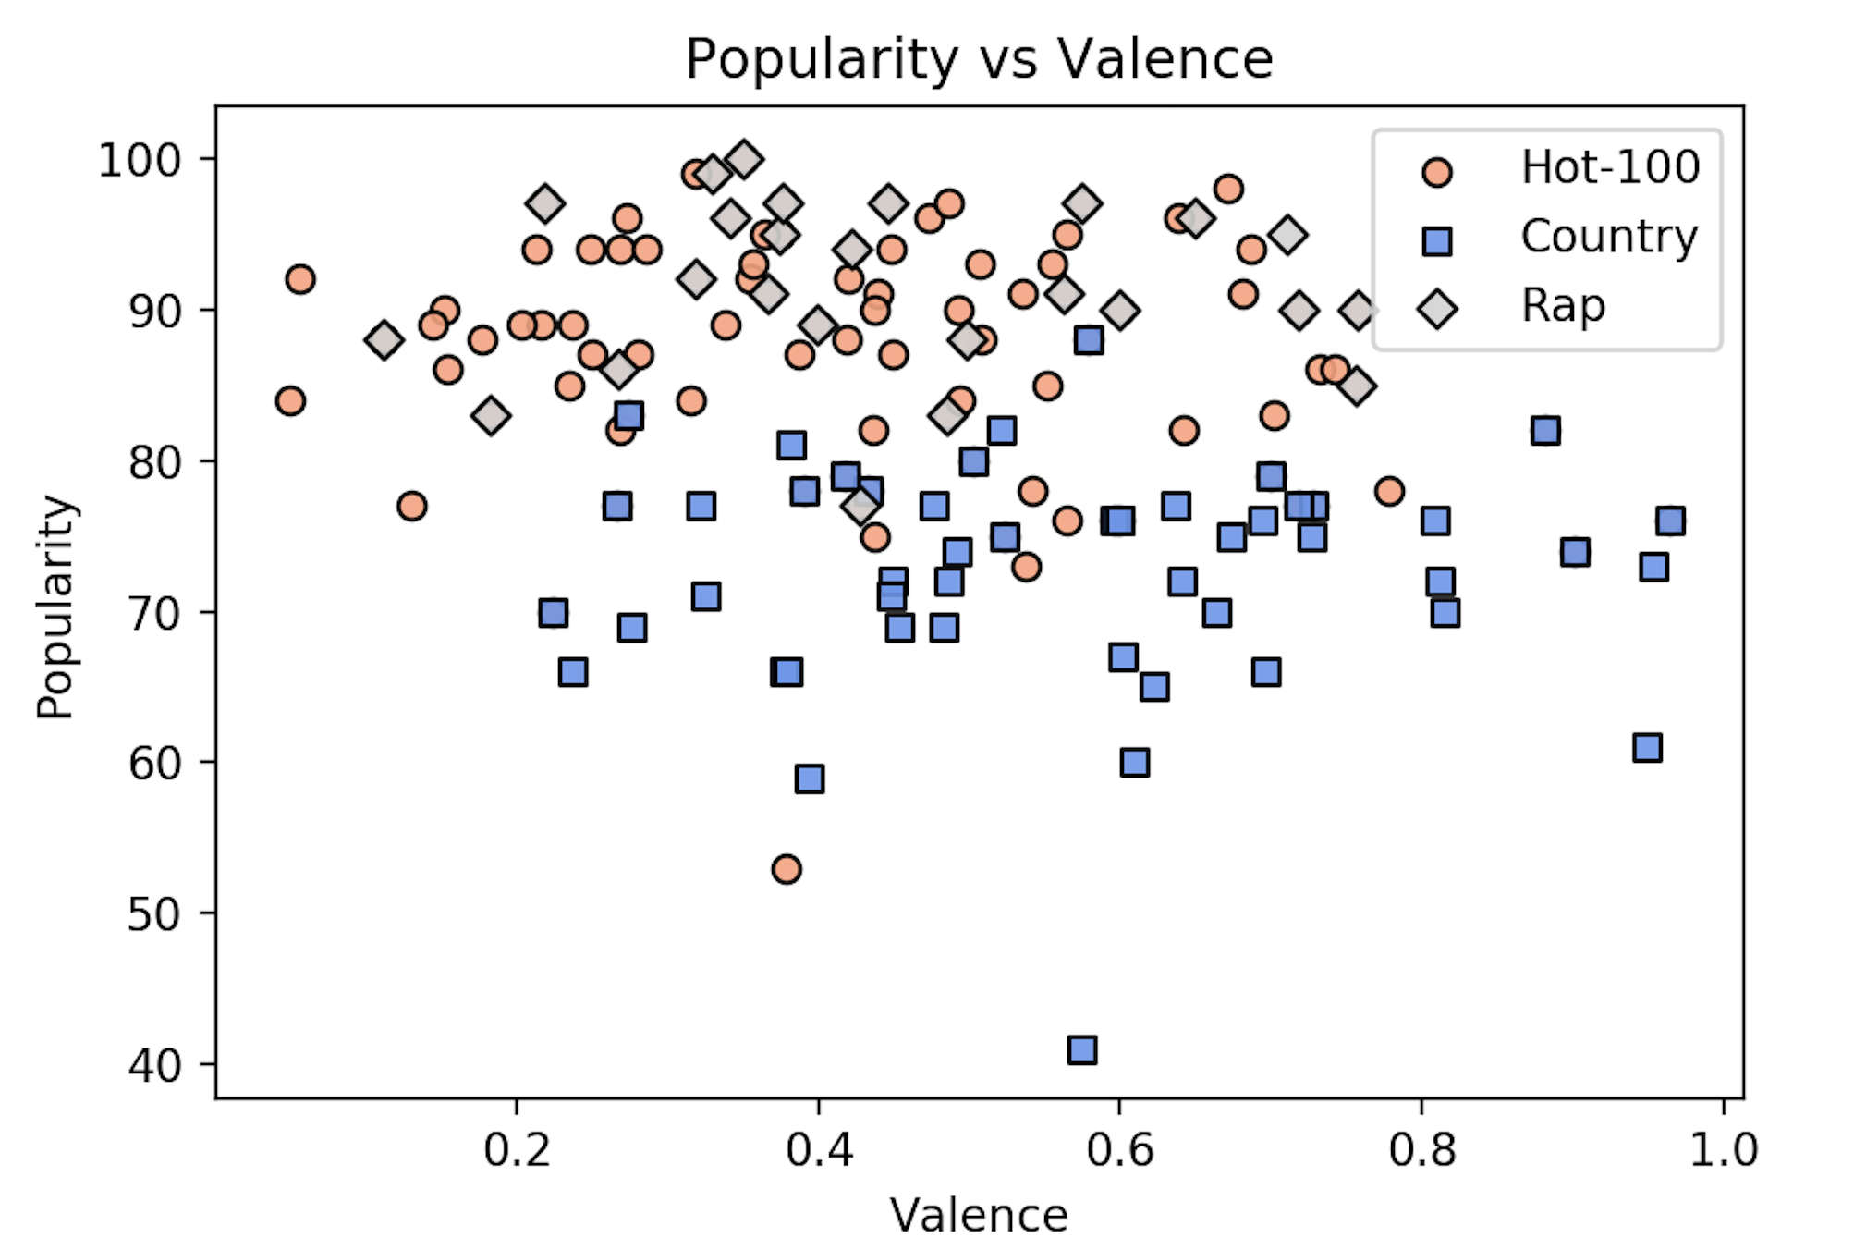
Popularity vs Valence

Slide 20
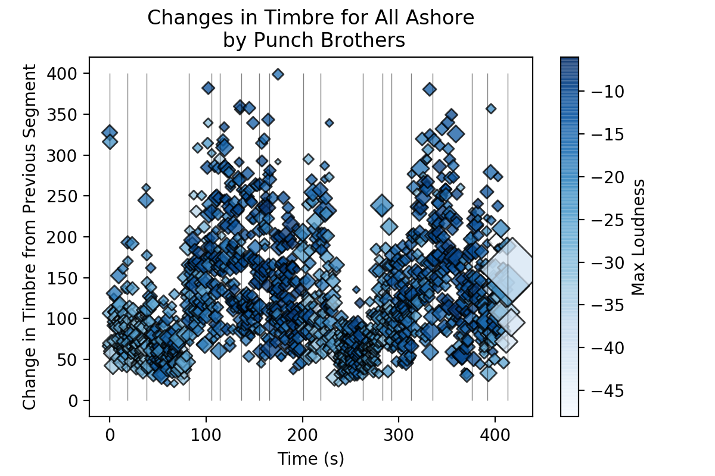
In Depth Analysis: Punch Brothers

Slide 21
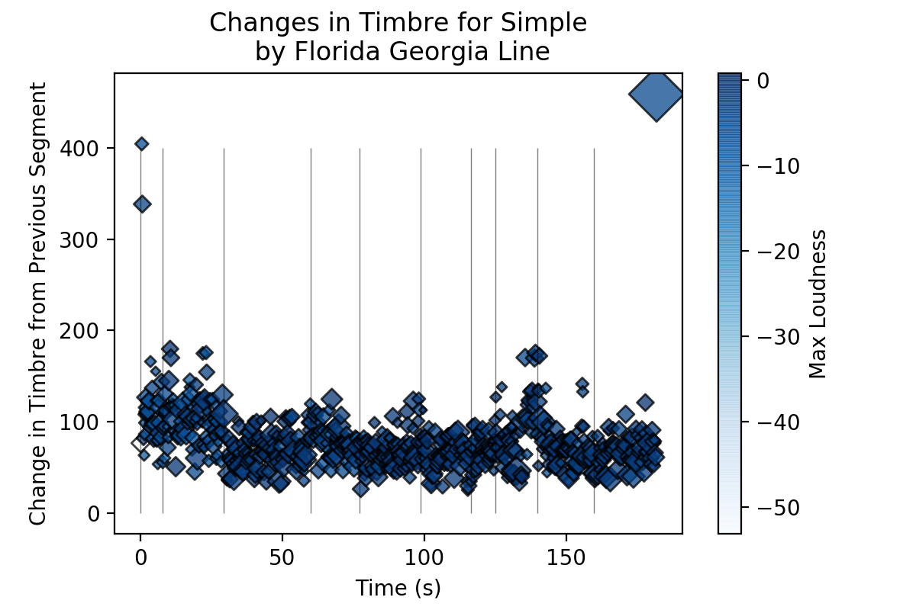
In Depth Analysis: Florida Georgia Line

Slide 22
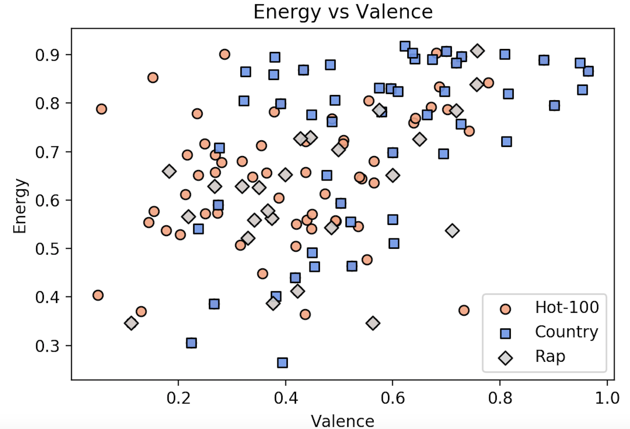
Energy vs Valence

Slide 23
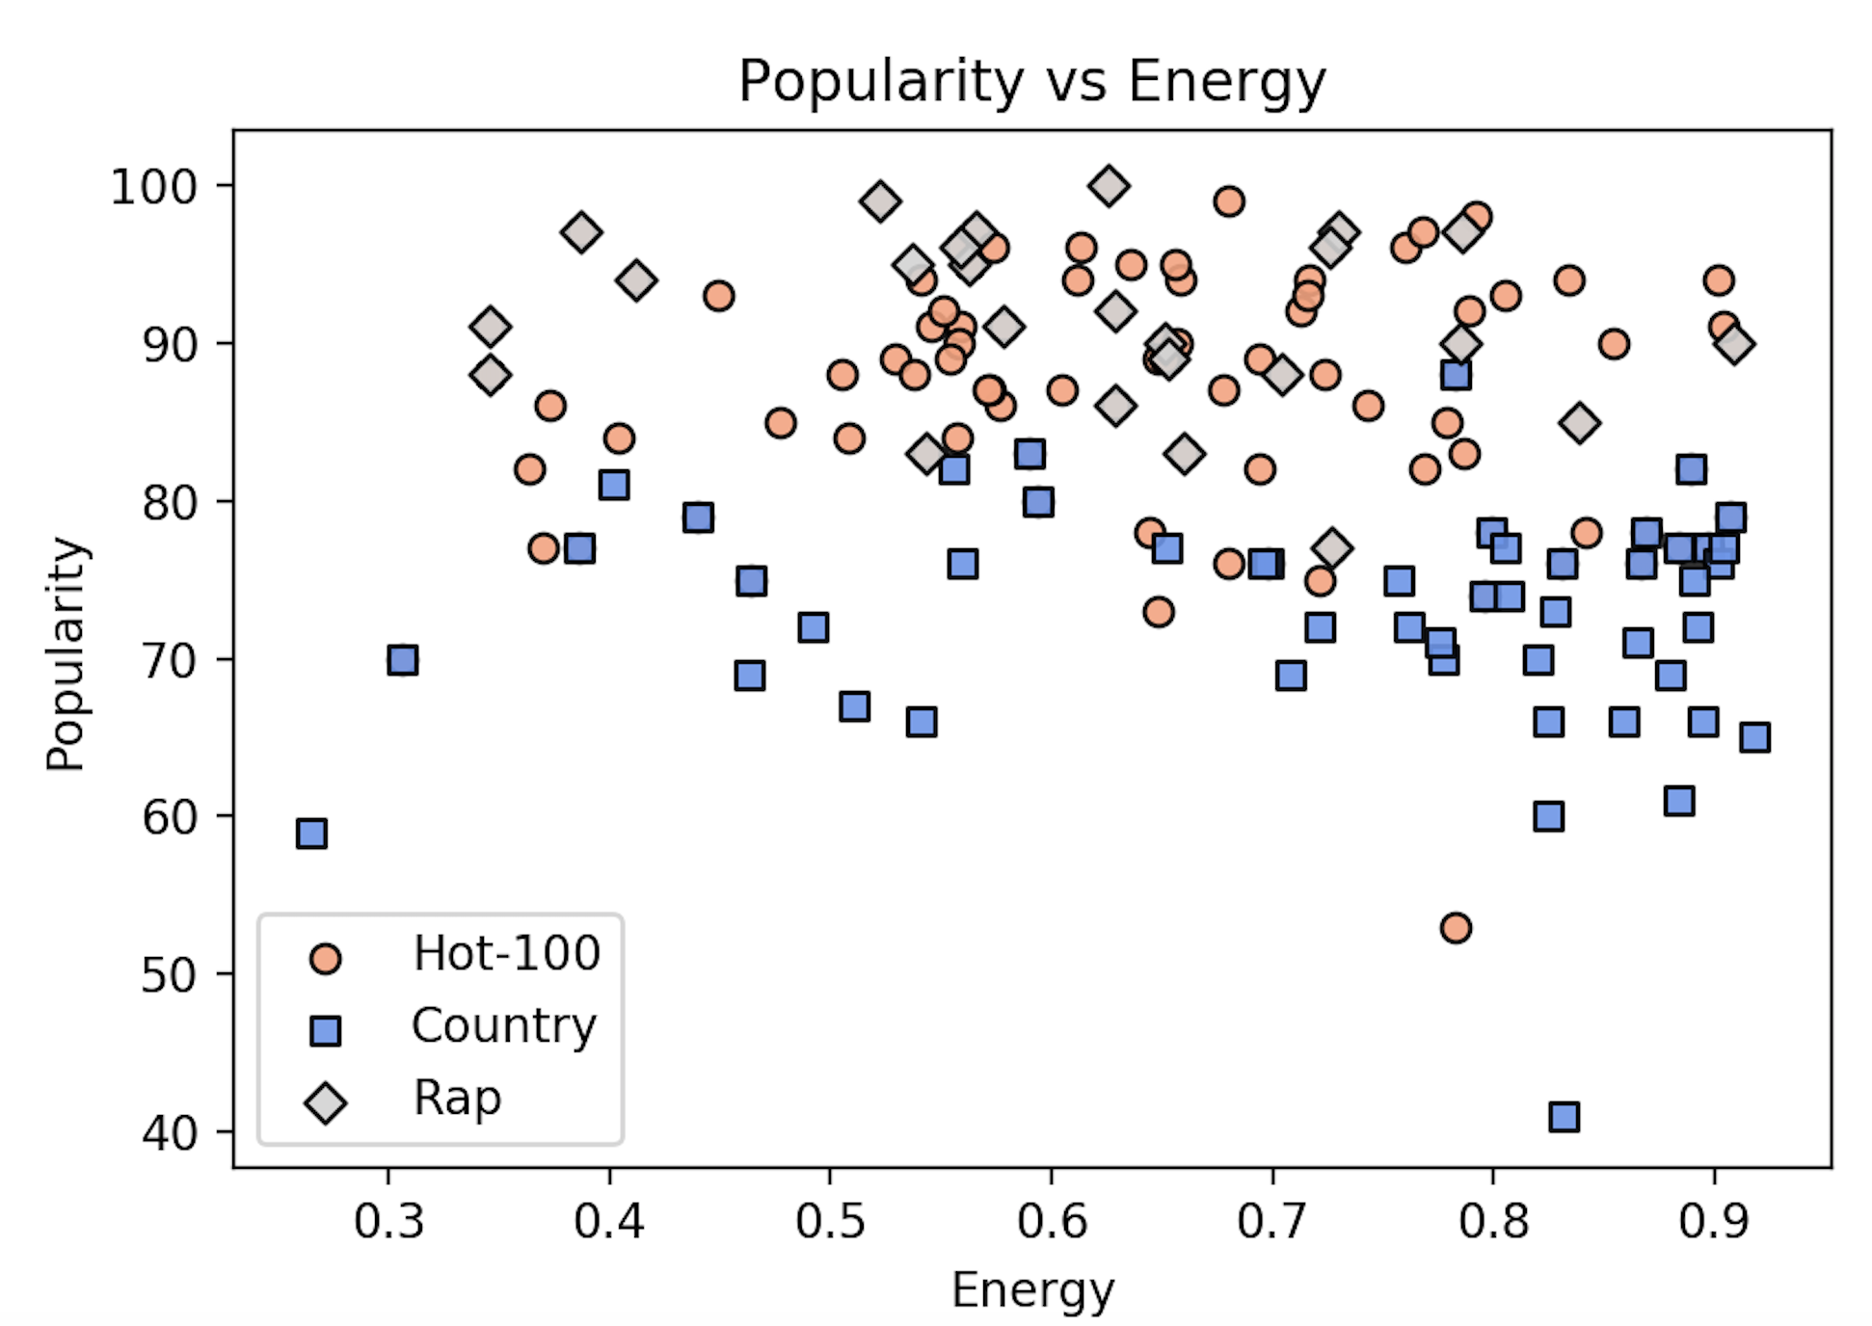
Popularity vs Energy

Slide 24
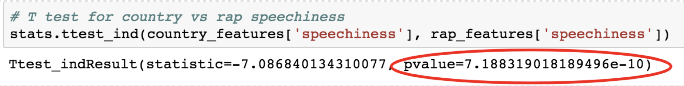
Is Country music more speechy than Rap?
H0 → No difference in speechiness b/w Country & Rap music
H Alt → There is difference in speechiness b/w Country & Rap music
T-test result
P-Value <0.05 (Reject H0)

Slide 25
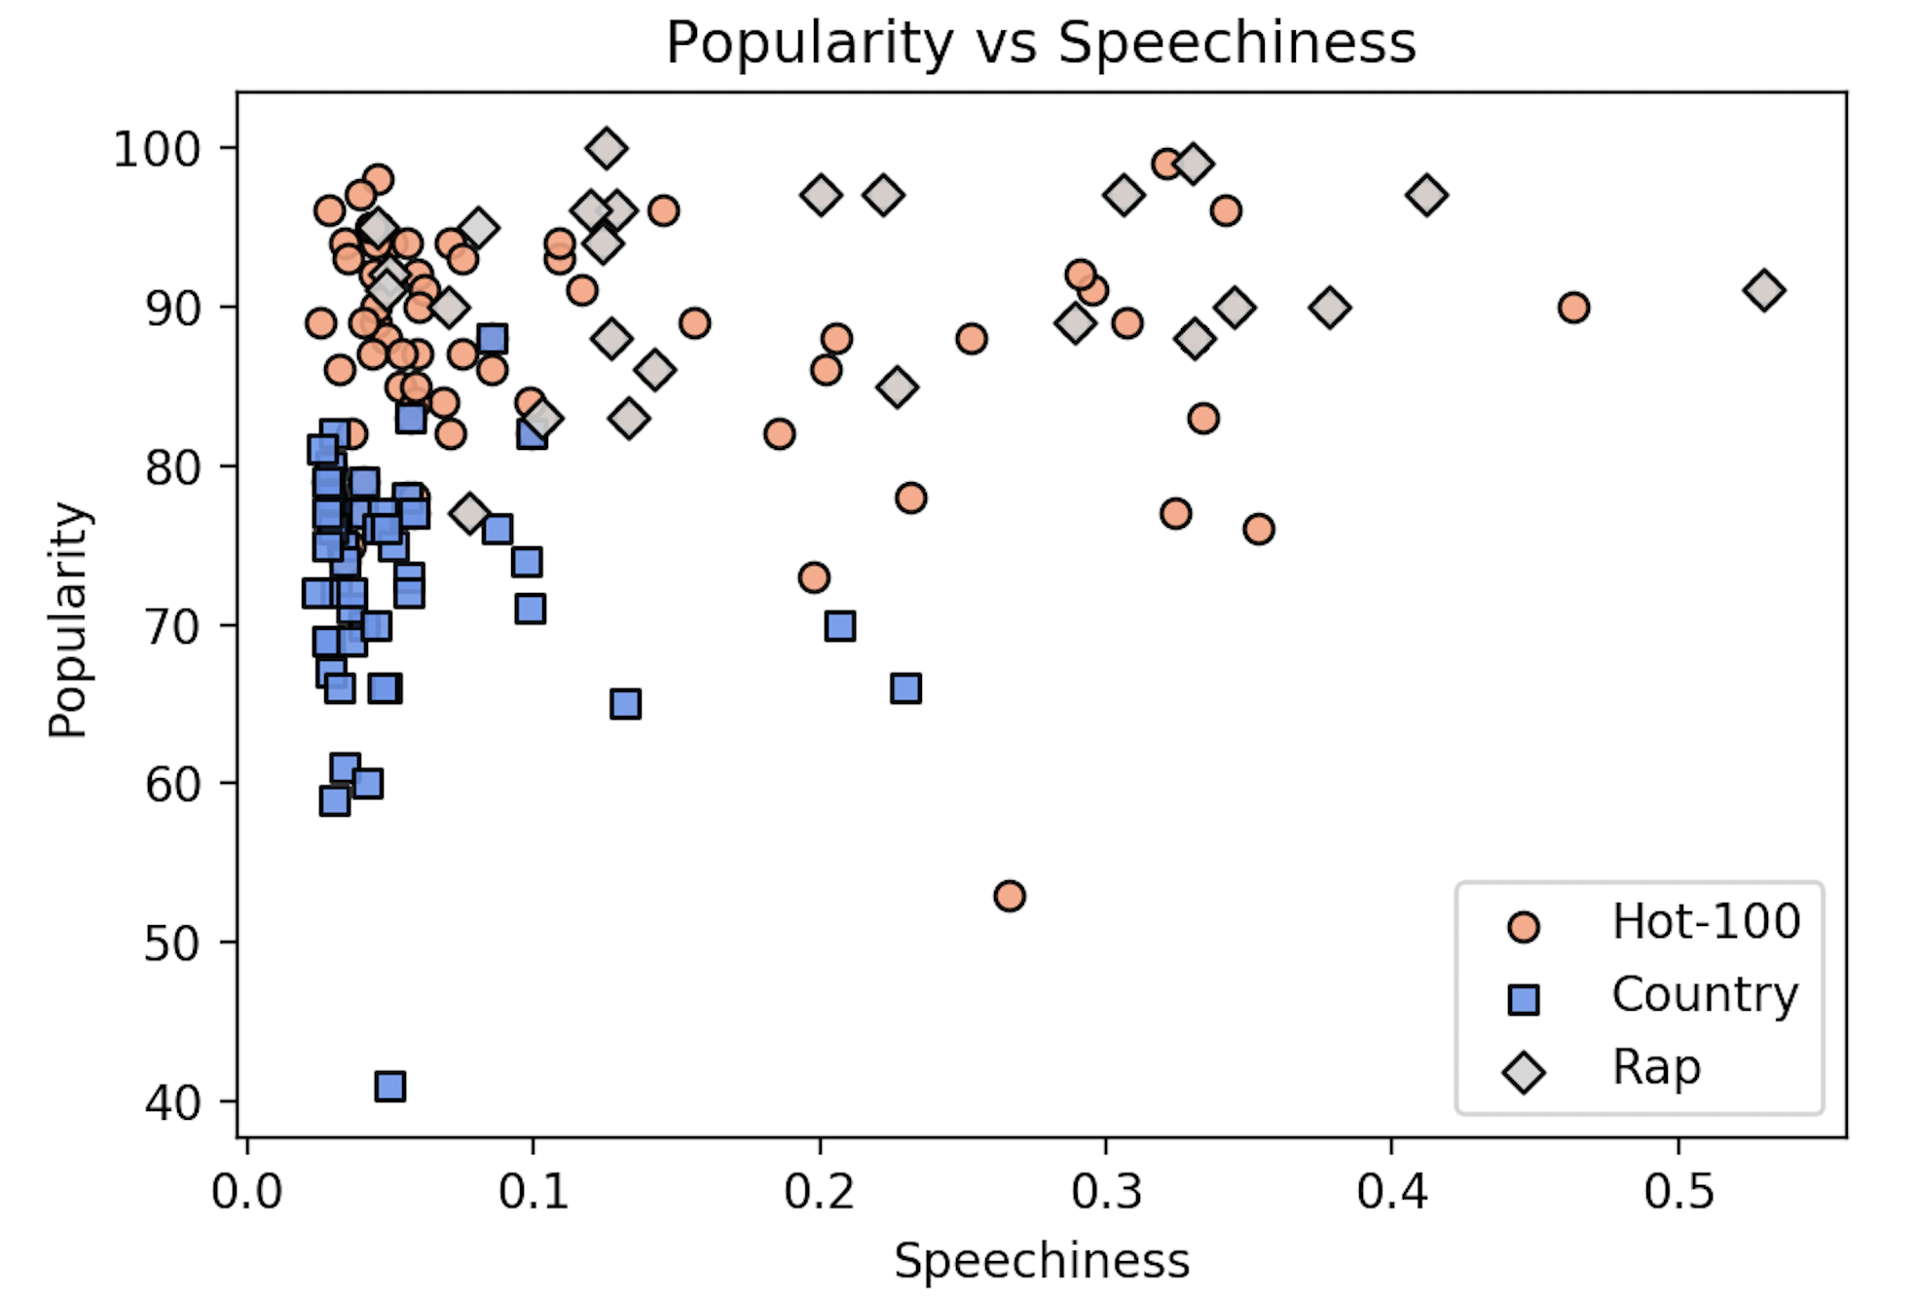
Popularity vs Speechiness

